Slide 1


Slide 2


January 2020
Market Research
June 2020
Requirements gathering
January 2021
Development begun
Full market launch
January 2022
October 2021
Pilot (Beta) launch
HOW IT STARTED
Notes:
Through existing clientele the need for a Van Sales solution was established.
It started off with soft requirements gathering and understanding the VS landscape.
Once we realised the true value and need for a robust Van Sales solution, we continued specing out the requirements in collaboration with companies with large scale van sales operations
By the start of January 2021, our development was underway.
Our excitement grew as we neared the MVP and by October 2021 we had our first couple clients running VS as part of our Beta launch.
From here, the development and support teams were running flat out to ensure the Beta launch was successful and the system was market ready by January 2022. The sales and marketing team were also in full swing preparing for the official launch.
So, what are some of the things we learnt during this journey….

Slide 3

CHALLENGES
Challenges
High Operating Costs
Inefficiencies
Risk of Fraud
Low Sales Volumes
Notes:
We found that Direct Store Delivery (DSD) models – also know as van sales, is a hot and getting hotter trend amongst the food and beverage sectors.
And with Van Selling, time is of the essence with a never-ending need for consistent turnover - this comes with its fair share of challenges.
High operating costs
Inefficiencies
Risk of fraud
Low sales volumes
BUT, on the up-side. If done right. Van Sales can save millions of dollars throughout the entire supply chain – improving the way products are ordered, sold, delivered and merchandised.
All the above hinges on the capabilities of the vendor’s van sales system

Slide 4

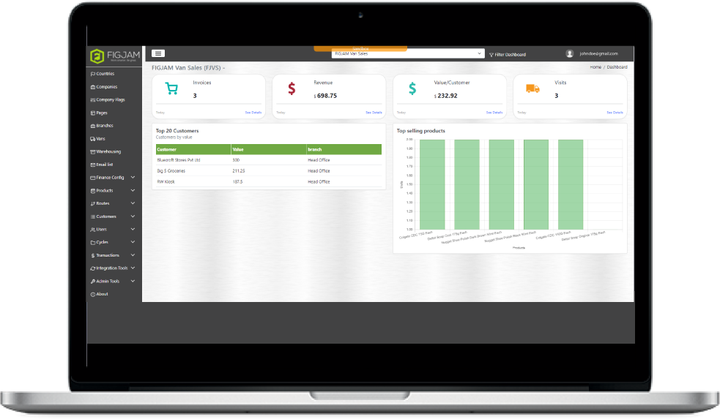
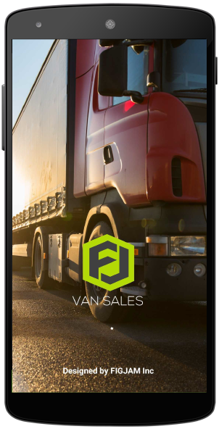
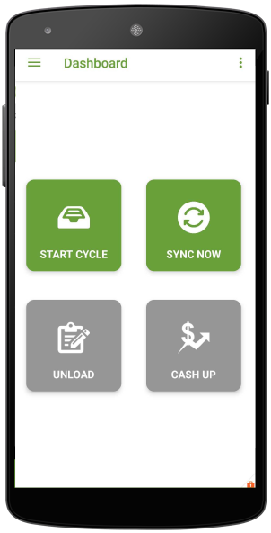
FLEXIBLE & COMPREHENSIVE
Notes:
And that’s where FIGJAM steps in….
With our flexible & comprehensive solution, enabling businesses to fully benefit and maximise from their Van Sales operations.
FIGJAM Van Sales ties in:
Field sales
Distribution logistics
Inventory management
Invoicing
Payment collection
With the capability of syncing this with the company’s ERP system at all times.
To provide effective operation tools and value-driven insights (move to next slide)

Slide 5

VALUE DRIVEN
Turnkey Solution
Scalability
Cut Costs
Market Share Growth
Increase the distribution depth
Improve invoice-cash cycle
Improve Product Awareness
Notes:
Some of the key areas we focus on are:
Providing a turnkey solution that is easy to plug and play
Cutting administration costs, transaction errors and fraud
Raising product awareness, customer loyalty, and quick launch to market for new products
Enabling field teams to increase the distribution depth
Creating a secure and improved invoice-to-cash cycle
Enabling companies to scale better
Ultimately, crating market share growth and profitability

Slide 6

INTUITIVE AT ALL USER LEVELS
Boost field force productivity
Improve Cross-sell/Up-sell opportunities
Offline BCP
Accountability & transparency
Efficient & Effective Route & Cycle Management
Security verification
In-field transactions & mobile receipt printing
Notes:
** Intuitive at all user levels.
Easy Administration
Branch & warehouse management
Vans
Finance configurations
Inventory Cataloguing
Efficient & Effective Route & Cycle Management
Customers
Real-time ERP and back-office integration
User-friendly features
Routes and model stocks
Load / Unloads (+ intra-day loads)
Security verification
In-field transactions & mobile receipt printing
End day settlements/reconciliations

Slide 7

ACTIONABLE INFORMATION
Dashboard Reporting
Activity management
Transactions
Live Stock Exposure
Day-end settlements/reconciliations
Variance Reporting
Notes:
** Providing actionable information for real-time insight

Slide 8




CONTACT US
CONNECT WITH US
www.figjammobile.com
sales@figjammobile.com

