Slide 1


Slide 2

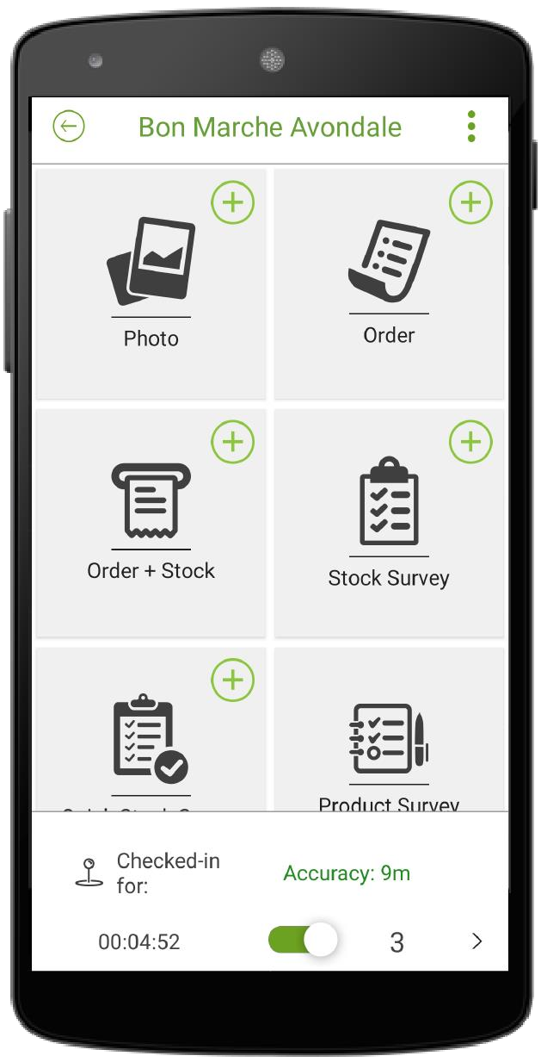

FIGJAM CASE STUDY
PHARMACEUTICAL DISTRIBUTOR–

Slide 3
Our Story.
INTRODUCTION
FIGJAM is an African software-as-a-service company that offers field management solutions, to companies in various sectors including the FMCG, Agriculture, Pharmaceutical, distribution and engineering industries. Its digital products are versatile and well suited to most businesses with field sales teams.
FIGJAM’s core digital products are Sales Force Automation (SFA) and
Van Sales.
FIGJAM’s offerings provide a strong product fit that aligns with Irvines’ digital strategy to provide coherent processes and systems to support its Market Access business’ mobile commerce digital initiatives.

Slide 4
CASE STUDY
SKY PHARMACEUTICALS

Slide 5




CONTEXT
INTRODUCTION
Sky Pharmaceuticals is a leading pharmaceutical and healthcare distributor based in Harare, Zimbabwe.
They represent a host of multinational companies and distribute their products countrywide.
Their product distribution is steered by a team of Sales and tele sales personnel covering pharmacies, private and government hospitals, clinics and healthcare facilities.
They also have a merchandising team manning supermarkets and wholesalers across the country .
To achieve this distribution function, the field teams make daily visits to interface with customers and facilitate order generation.

Slide 6

CHALLENGE
INTRODUCTION
Being in various markets countrywide, Sky Pharm had a requirement for a field management solution to effectively coordinate and track their customer visits.
Furthermore, a sales enablement tool was needed to generate orders and quotes from the trade.
There was also a time gap between order generation and fulfillment so real-time data access was an immediate need.
Sky Pharm lacked a standardised solution to digitally capture customer feedback from their clients.

Slide 7


SOLUTION
INTRODUCTION
An integrated mobile sales ordering platform to the Enterprise Resource Planning (ERP) system (SAGE) was created.
The integration layer also synchronises static data across to the FIGJAM system, ensuring automatic upkeep of customers, products, pricing and stock on hand.
Quotation generation and dissemination to customer was enabled on the platform
Mobile visit management functionality was implemented to create call- cycles/routes and report customer visits with time spent on service delivery.
Customer Surveys were automated into digital questionnaires enabling data collection by field reps
Finally, Business Intelligence (BI) reports were set up as per Sky’s reporting requirements to facilitate the principal level reports for Sky.

Slide 8

IMPACT
INTRODUCTION
The Implementation & functionality of FIGJAM’s solution was applied according to specific business operational requirements/challenges in each market. This approach ensured that Sky Pharm as a business is appropriately empowered to enhance its service delivery.
Orders are seamlessly posted to the ERP in real-time from the field. This cuts down processing times and double-handling of orders.

Slide 9

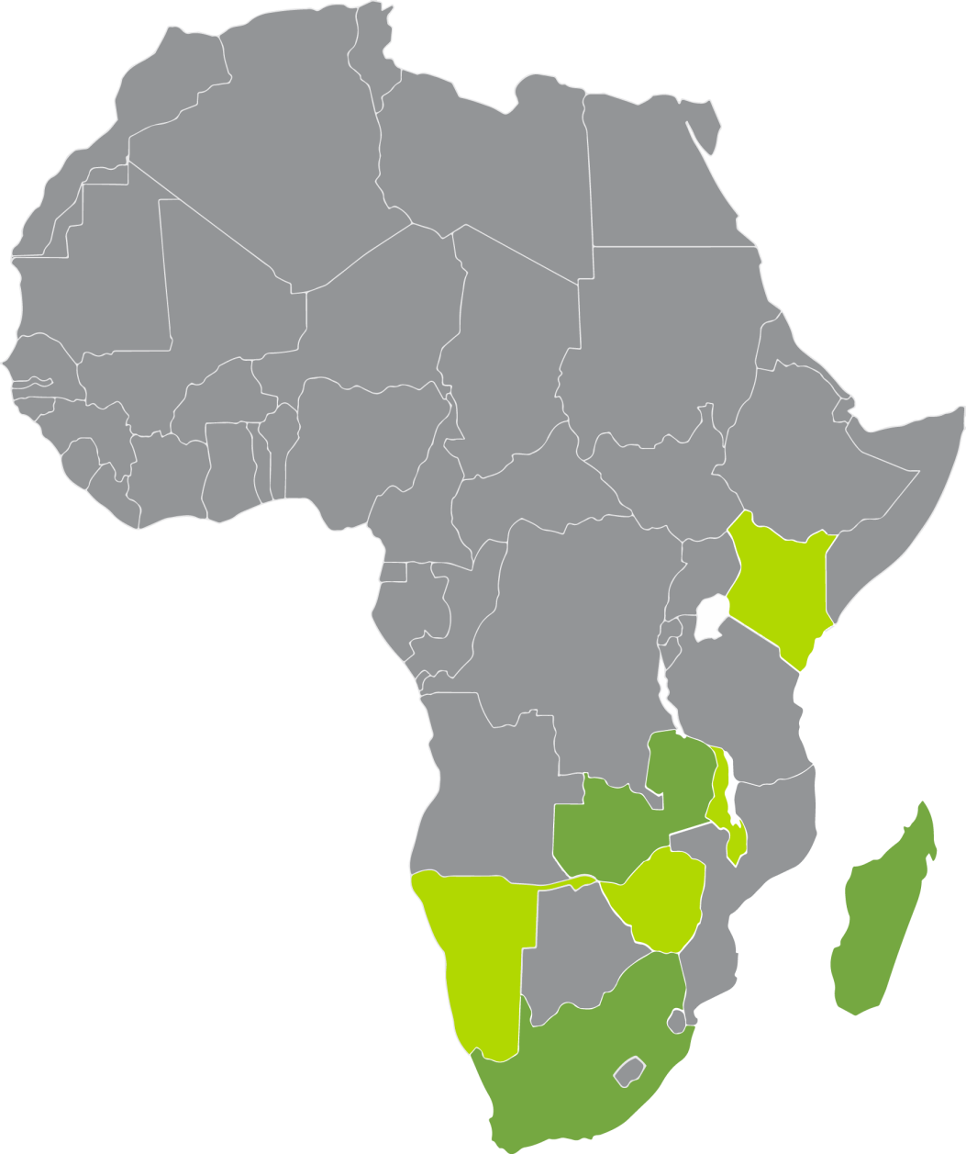
AFRICA’S PREFERRED
SOLUTION

Slide 10




CONNECT WITH US
CONTACT US
www.figjammobile.com
sales@figjammobile.com

