Slide 1
CONTENT DOCUMENT

Slide 2
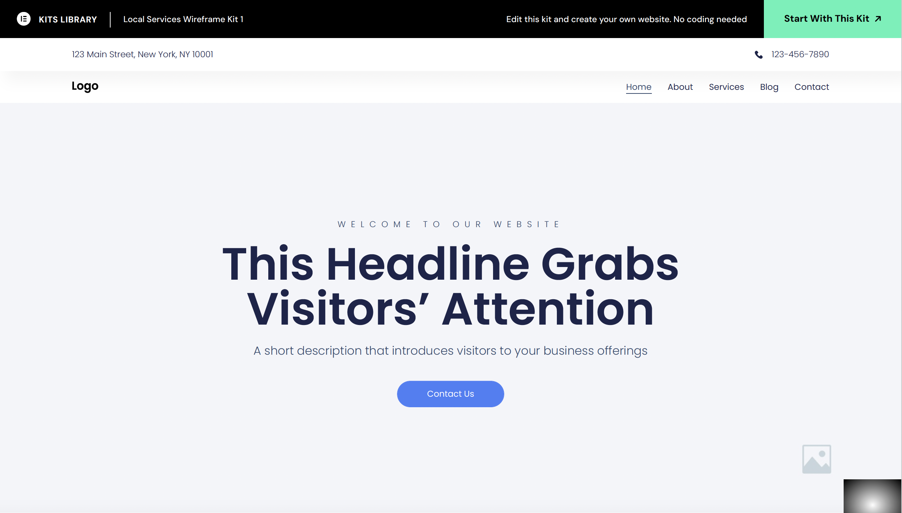
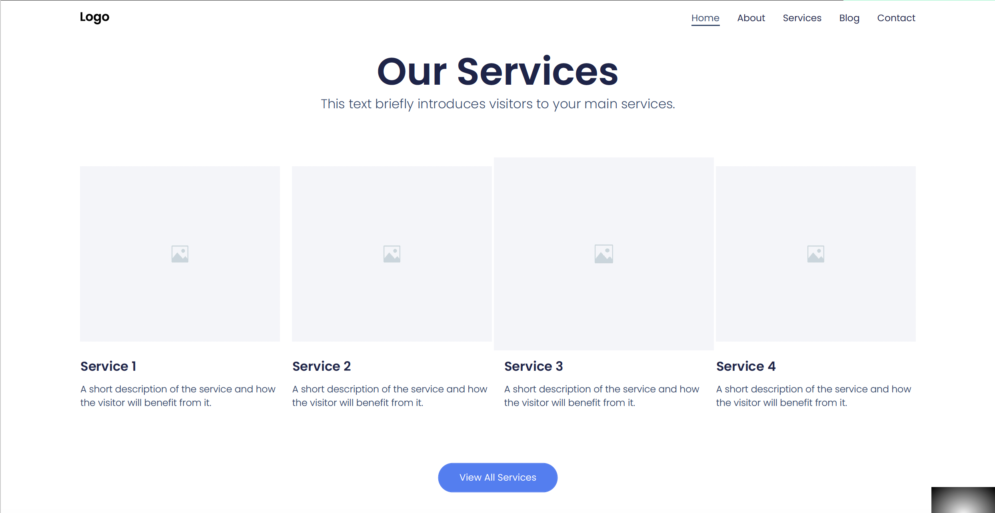

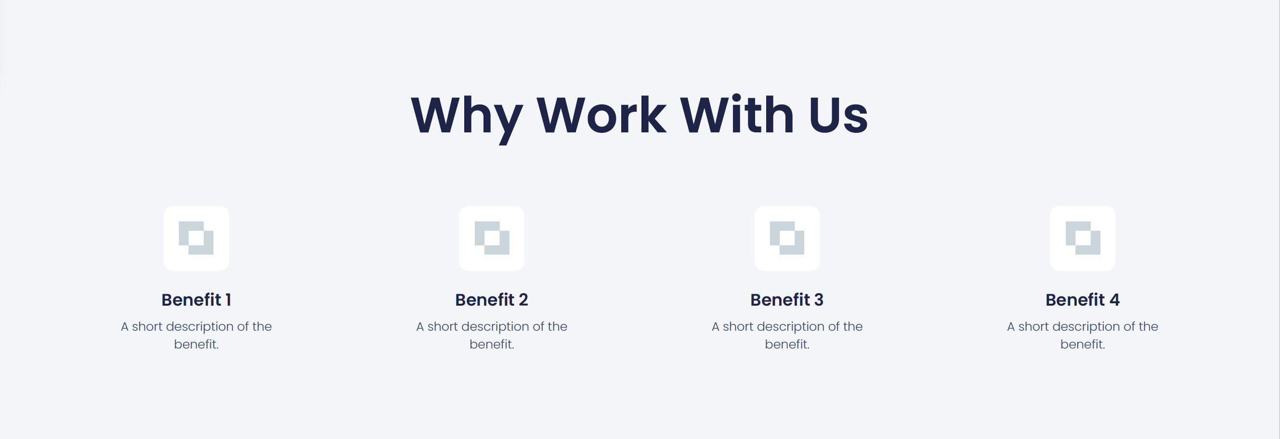






Local Services Wireframe Kit 1
CONTENT: HOME
A Leading Provider of Turnkey Renewable Energy Solutions
Delivering tailored, cost saving energy solutions to commercial, industrial, property and agricultural clients
Use a Mercedes plant photo as background image
Learn more
Get a quote
Our Solutions
We provide tailored Solar Photovoltaic (PV) and Battery Energy Storage Solutions (BESS) to meet the needs of each of our clients
Image
Image
Image
Image
Power Purchase Agreement (PPA)
Benefit from solar energy without the upfront cost
Outright Purchase
Provides immediate ownership benefits i.e. tax incentives and energy savings
System Buy Back
Provides flexibility and potential to restructure financial obligations
Operations & Maintenance
Outsource O&M to us to allow you to focus on your core business activities
Two Decades In Energy
BrightBlack Energy has been in the energy space since 2004 and pioneered occupancy sensor technology in SA with over 5mil m² made efficient with energy management solutions
Providing turnkey renewable energy solutions to commercial & industrial clients since 2013
As discussed with Ian, we want to be able to update these stats via an input function
Learn more
We Deliver End-To-End Solutions
Design, Build, Finance, Operate and Manage
30MW+
Solar PV Installed
50k+
Solar Panels Installed
2MWh+
Battery Storage Installed
100+
Projects Completed
Pictures of Mercedes project
Largest Rooftop Solar Project In South Africa
BrightBlack Energy has a strong track record of delivering projects of various sizes, from schools to large manufacturing plants
View more projects
Client Testimonials
* Leave placeholders for testimonials
Our Clients
[insert logos of clients (client list below in no particular order)]
Mercedes-Benz, Divercity, Abagold, Westcoast Abalone, Deetlefs Wine Estate, Emira Property, Goscor, KPMG, Mercedes, OK Foods, Waterford Wine Estate, Evergreen Lifestyle, Val de Vie, Shoprite, Checkers, University Stellenbosch, Toyota
** Don’t need this section
Secure Your Company’s Energy & Start Saving
Go green, secure your energy and save money – all at the same time!
Contact us
Assume everything for this section except ‘Get In Touch’ will be taken from content provided
Get In Touch
Western Cape Office
1st Floor, La Gratitude, 97 Dorp Street Stellenbosch
Gauteng Office
Ground Floor, Cradock Heights, Cnr Tyrwhitt & Cradock Avenue, Rosebank, Johannesburg
Email: consult@brightblack.co.za
Phone: 010-0150700
Hours: Mon-Fri 8:00AM – 5:00PM

Slide 3
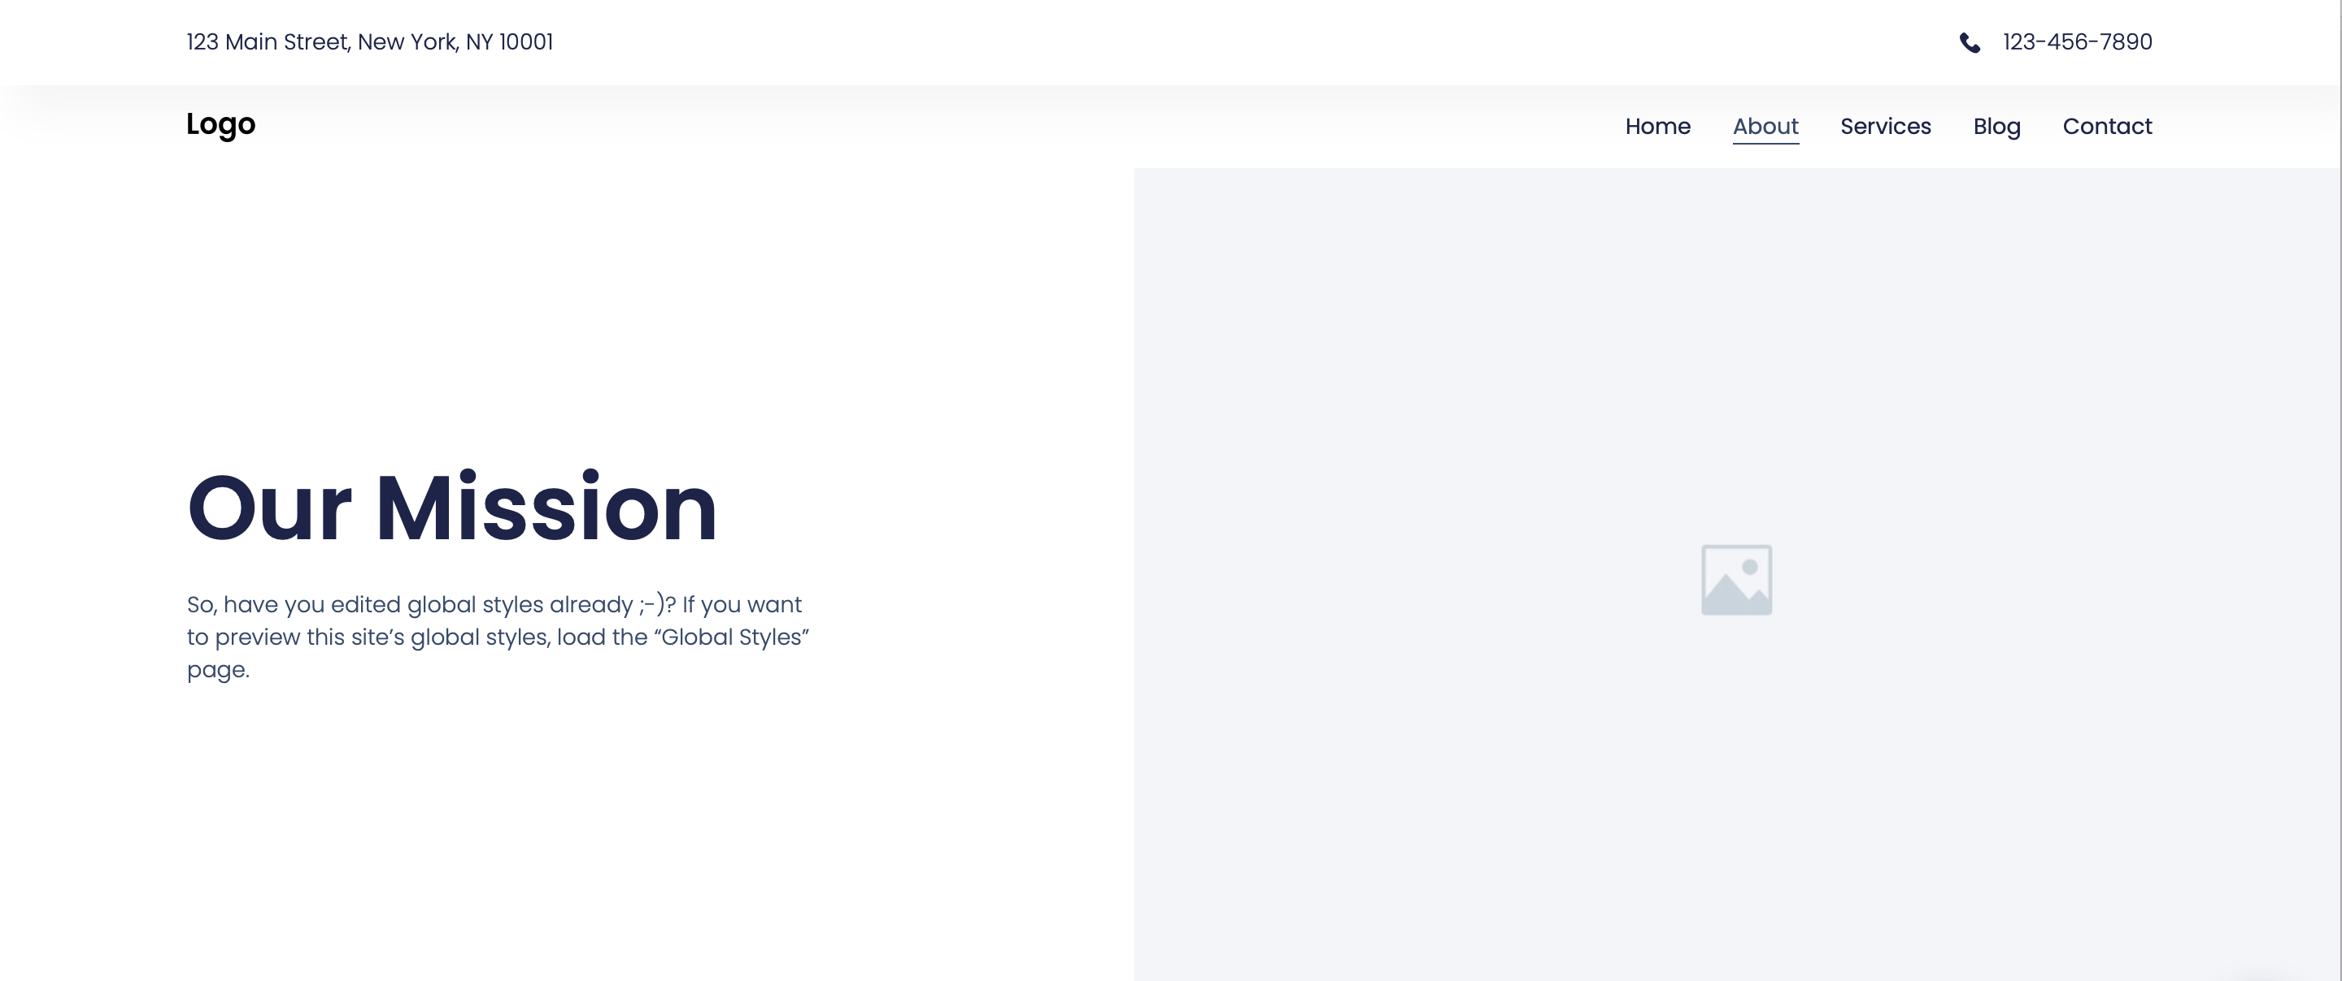

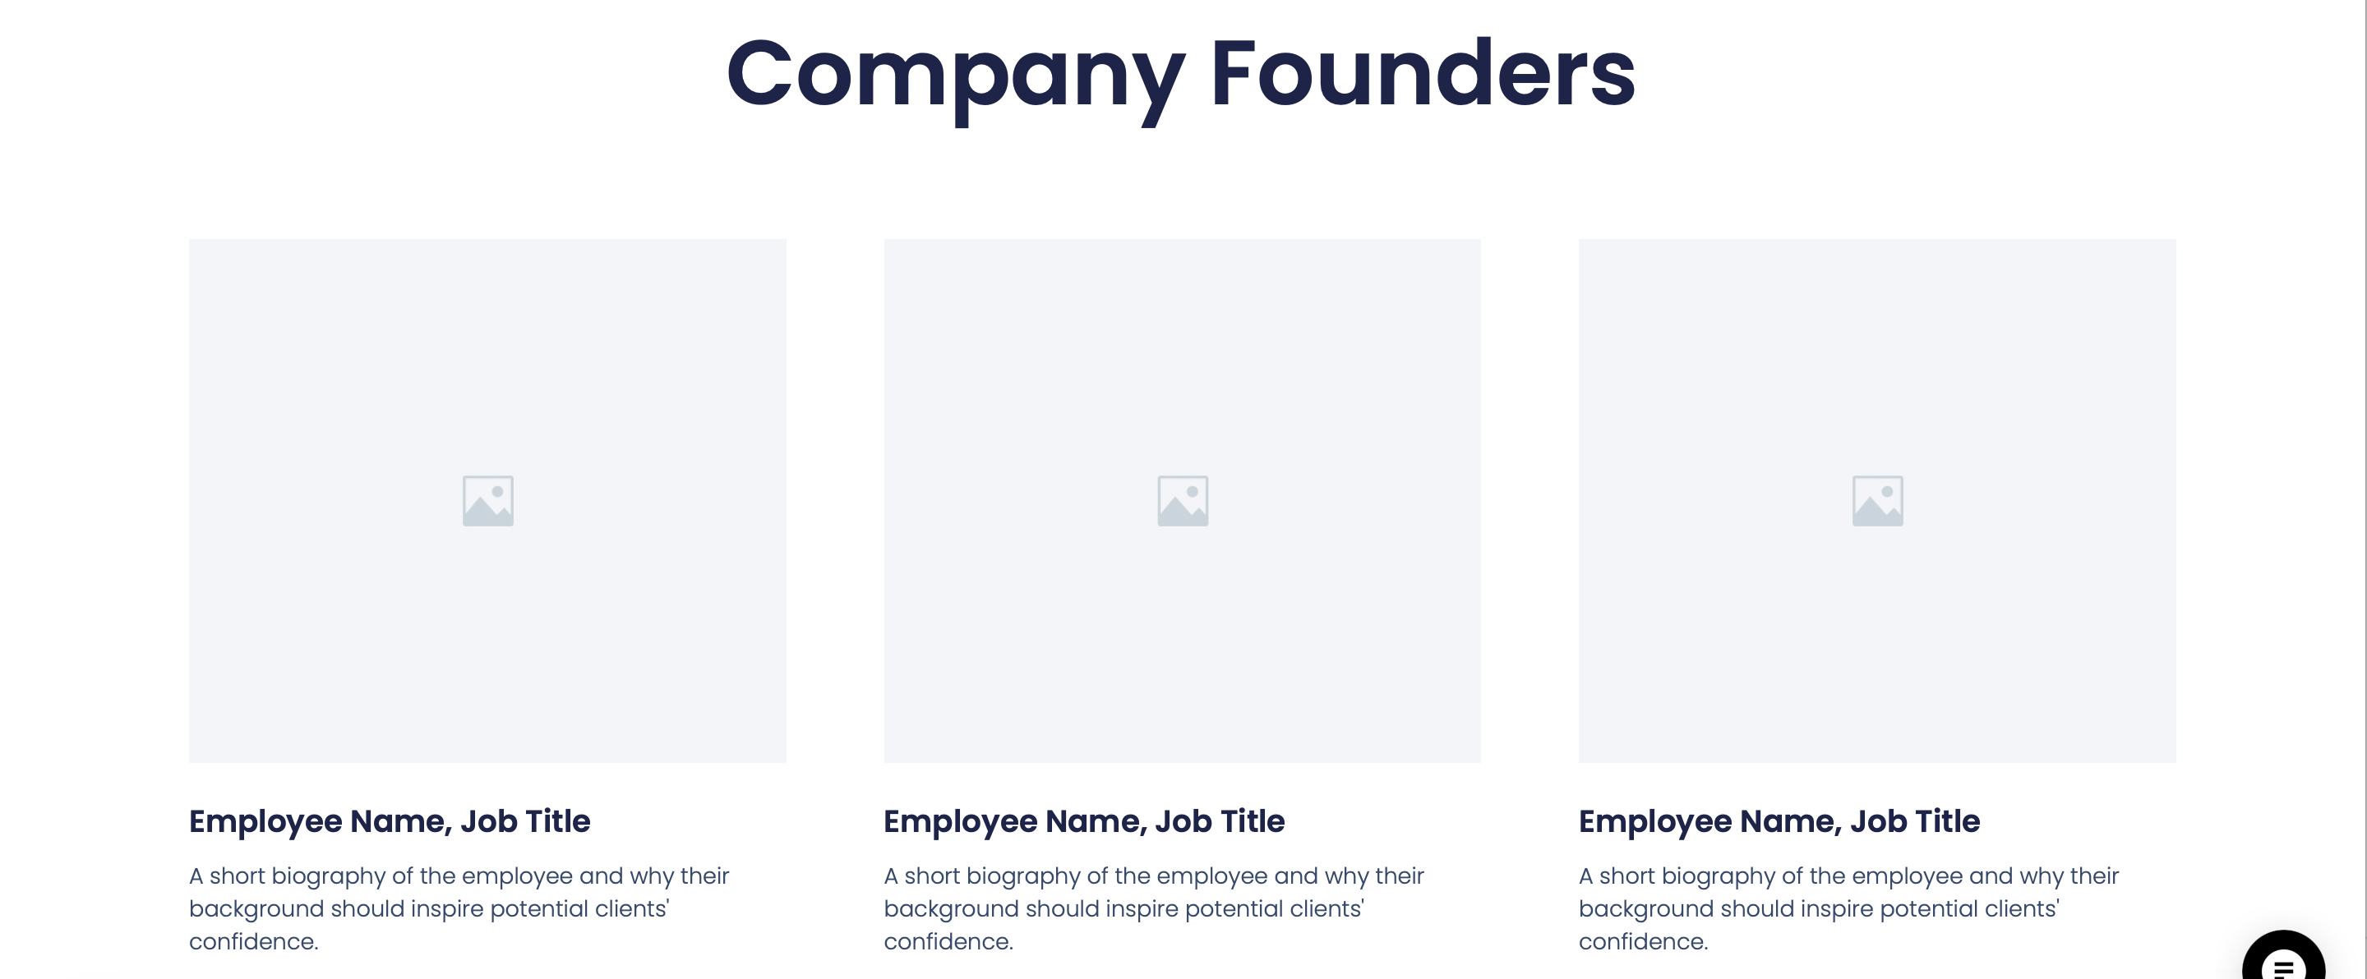




Local Services Wireframe Kit 1
CONTENT: ABOUT
Our Mission
At BrightBlack Energy, we empower businesses and industries with sustainable and efficient energy solutions. By transforming rooftops into powerhouses, we help our clients reduce their carbon footprint and operational costs with innovative solar installations. Our commitment to excellence, integrity, and environmental stewardship drives us to deliver tailored solar systems for a brighter, cleaner, and more prosperous future. Together, we harness the power of the sun to build a sustainable tomorrow.
Our Vision
At BrightBlack Energy, our vision is to lead South Africa's transition to a sustainable energy future as the foremost provider of rooftop solar solutions for commercial, industrial, property, and agricultural clients. We envision businesses thriving on clean, renewable energy, reducing their environmental impact, and fostering economic growth. Through innovation, quality, and commitment to our clients and the planet, we aim to make solar power central to every business's energy strategy, paving the way for a resilient and sustainable economy.
Can we replace the company founders section with a section that cover the following?
What We Do
BrightBlack Energy is a South African energy solutions provider specialising in the design, procurement, construction, finance, operation and management of Solar Photovoltaic (PV) and Battery Energy Storage Solutions for commercial, industrial, property and agricultural clients.
Our History
Established in 2003 our initial entry point into the market was to optimise the energy efficiency of commercial properties. A great deal of value was delivered to our clients who continue to save millions of Rands with over 5 million square meters of office space that was made efficient. In 2013 we established our solar devision and since then it has become our focus to provide turnkey renewable energy solutions. Our solutions mainly consist of solar PV and battery storage solutions that we deliver as solutions purchased outright by clients or as financed solutions depending on our clients’ needs. We have more than 30MWp of completed projects and projects under development. BrightBlack Energy is a privately held company backed by seasoned entrepreneurs. It is 51% black owned and a Level II B-BBEE contributor.
"At BrightBlack Energy, we lead the charge towards a sustainable energy future. Harnessing rooftop solar and innovative distributed energy solutions, we empower businesses to achieve energy independence, reduce costs, and contribute to a cleaner planet. Together, we're building a resilient and prosperous energy landscape for generations to come."
— Etian Louw, Growth Executive at BrightBlack Energy
<same as home page>
<same as home page>
<same as home page>

Slide 4
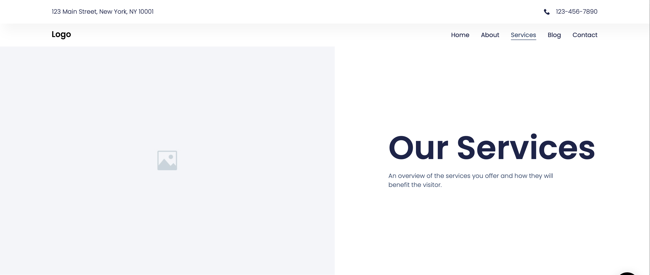
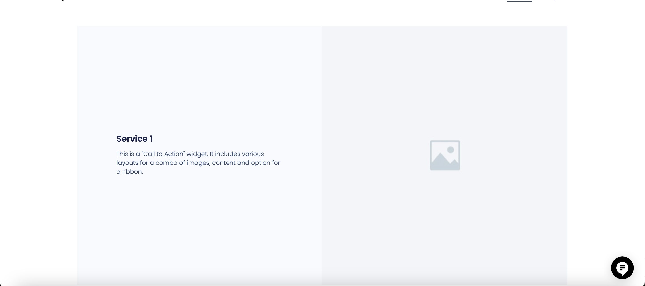

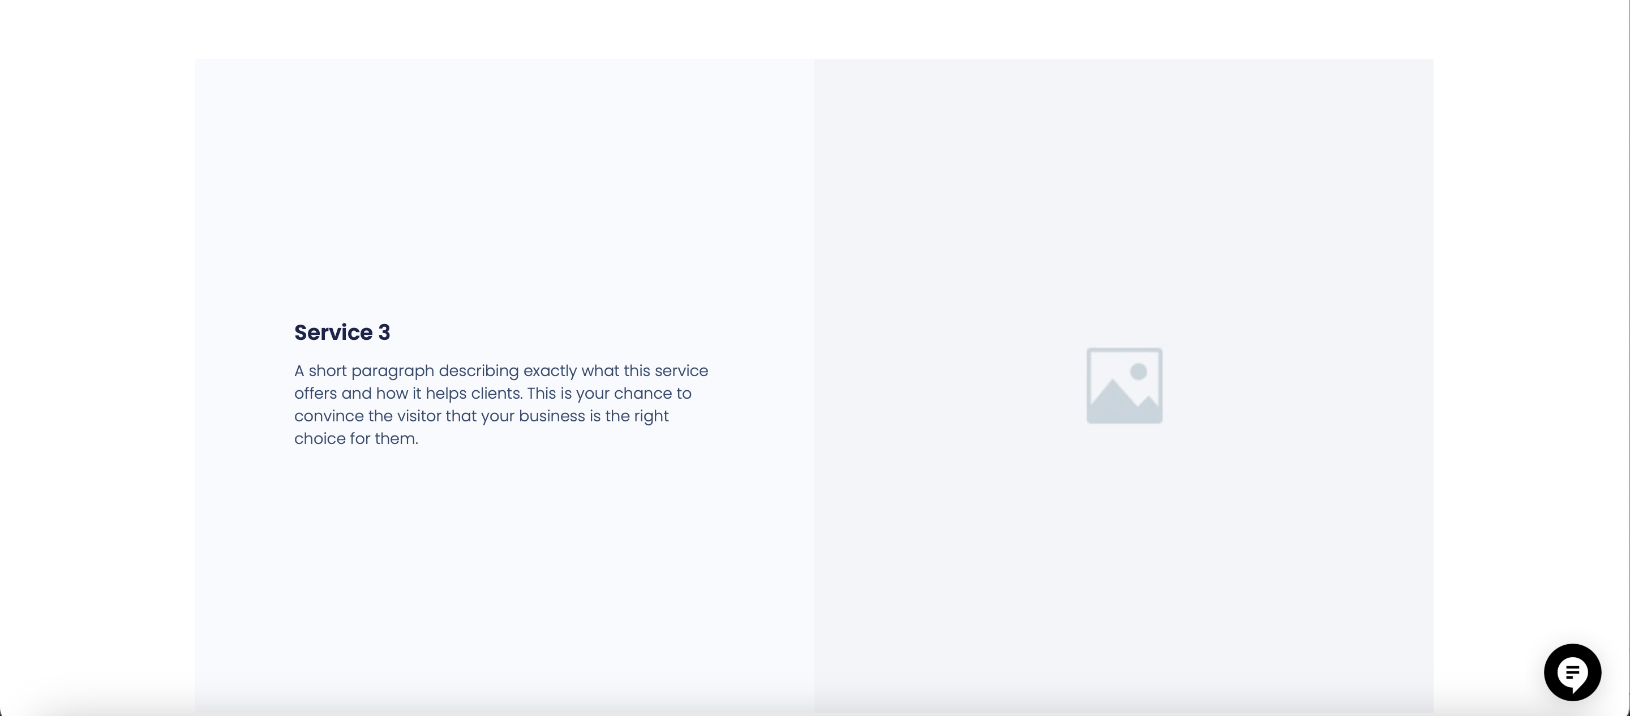

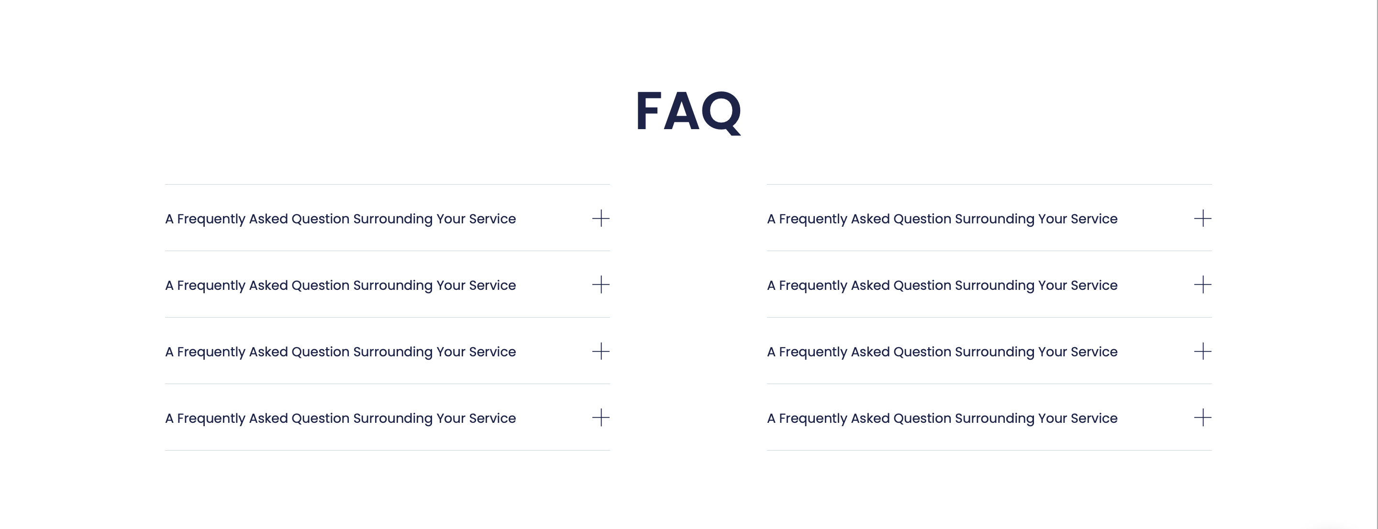


Local Services Wireframe Kit 1
CONTENT: SERVICES
Turnkey Renewable Energy Solutions
BrightBlack Energy specialises in designing, installing, and maintaining rooftop solar and battery storage systems for commercial, industrial, property, and agricultural clients. We provide comprehensive solutions tailored to meet the unique energy needs of each business.
Power Purchase Agreement (PPA)
A Power Purchase Agreement (PPA) allows our client to benefit from solar energy without the upfront cost of purchasing and installing the system themselves.
We fund, install and maintain the solar system on the client's property. The client agrees to purchase the electricity generated by the system at a predetermined rate over a fixed period, often ranging from 10 to 20 years.
We retain ownership of the solar equipment and is responsible for its maintenance and operation during the term of the PPA.
Outright Purchase
An Outright Purchase provides immediate ownership benefits, including potential tax incentives and long-term savings on electricity costs as the system generates power over its lifespan.
This option refers to the client buying the solar energy system outright from us. This involves a one-time payment for the entire cost of the solar panels, inverters, and other necessary equipment payable on project milestones.
Once purchased, the client owns the solar system and is responsible for its maintenance and operation.
System Buy Back
A System Buy Back allows a client to sell their solar system to us at an agreed-upon price, providing flexibility and potentially reducing the financial risks and balance sheet burden associated with long-term ownership.
This option typically involves scenarios where the client initially purchases a solar energy system outright or through financing, which the client wishes to change to a PPA due to changing circumstances or to manage financial risks.
Such a buy back can also be incorporated with enhancing the existing solar system with the incorporation of a battery energy storage solution.
Operations & Maintenance
Operations and Maintenance services encompass the ongoing support and upkeep required to ensure the optimal performance and longevity of the solar energy system.
This includes regular inspections, cleaning of solar panels, monitoring of system performance, troubleshooting and repairs, as well as handling any necessary paperwork related to warranties or regulatory compliance.
By outsourcing O&M to us, clients can focus on their core business activities while ensuring their solar investment continues to deliver maximum efficiency and savings.
* FAQ
See FAQs listed on separate page below
<same as home page>
<same as home page>

Slide 5
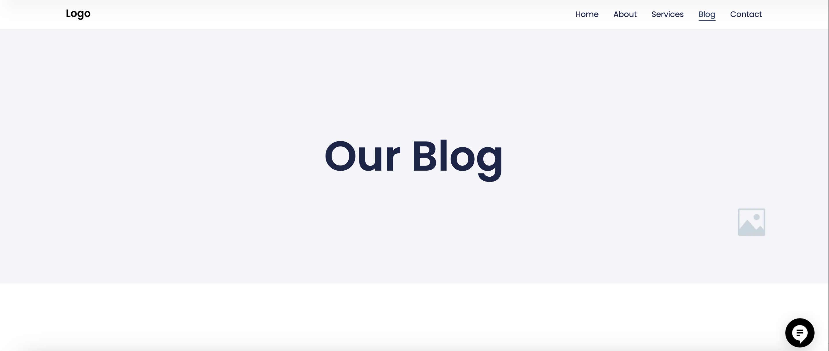

Local Services Wireframe Kit 1
CONTENT: PROJECTS
Assuming the blog template can be used for our projects page
Space for brief descriptions of our projects should be fine. We don’t need to ‘Read More’ options
Can you lift the existing projects from our existing website?
And then we can add more projects using the functionality that will allow us to load new projects.
Can projects automatically be ordered by date that we insert from oldest at the bottom to latest at the top of the page?
etc.
<same as home page>
<same as home page>

Slide 6
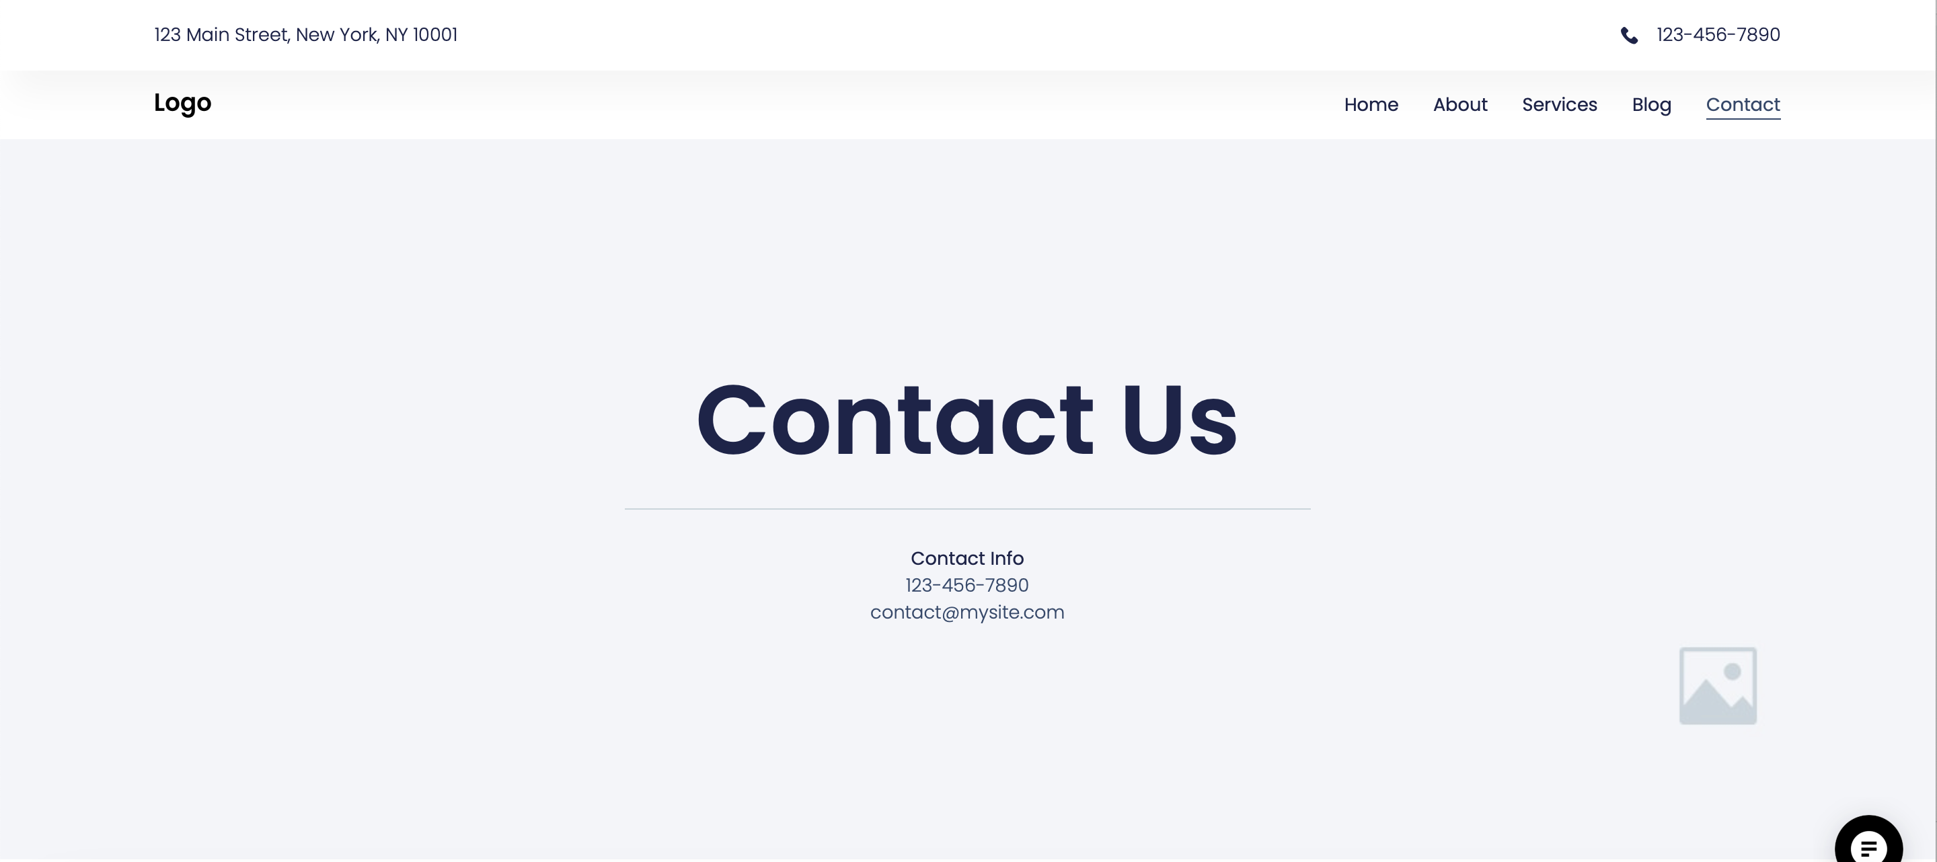

Local Services Wireframe Kit 1
CONTENT: CONTACT
010-0150700
consult@brightblack.co.za
Can we have the following fields in the contact us form:
Name *
Surname *
Email address *
Contact number *
Business name *
Business address *
Solution interested in * (drop down: Solar Solution, Battery Solution, Solar & Battery Solution)
Estimated monthly energy consumption (in kWh)
Message * (What would they like to enquire about?)
<same as home page>
<same as home page>
<same as home page>

Slide 7
CONTENT: FAQs
Frequently Asked Questions (FAQs)
1. What services does BrightBlack Energy offer?
- BrightBlack Energy specialises in designing, installing, and maintaining rooftop solar and battery storage systems for commercial, industrial, property, and agricultural clients. We provide comprehensive solutions tailored to meet the unique energy needs of each business.
2. How does rooftop solar work?
- Rooftop solar systems capture sunlight using photovoltaic (PV) panels and convert it into electricity. This electricity can be used to power your business operations, reducing reliance on the grid and lowering energy costs.
3. What are the benefits of installing a rooftop solar system?
- Benefits include significant cost savings on energy bills, reduced carbon footprint, energy independence, and potential revenue from excess energy fed back into the grid.
4. How much can I save with a rooftop solar system?
- Savings vary based on factors such as the size of the system, energy consumption, and local electricity rates. Our team can provide a detailed savings estimate based on your specific situation.
5. Is my business eligible for any incentives or rebates?
- Yes, there are incentives available to businesses that invest in solar energy. Our experts will help you navigate these opportunities to maximize your savings.
6. How long does the installation process take?
- The installation timeline depends on the size and complexity of the project. Typically, commercial installations take between a few weeks to a few months from initial consultation to system activation.
7. Will installing solar panels disrupt my business operations?
- We strive to minimize any disruptions during the installation process. Our team works efficiently and can schedule installations in consultation with you to reduce impact on your business.
8. What kind of maintenance is required for rooftop solar systems?
- Solar systems require minimal maintenance. Regular cleaning and periodic inspections ensure optimal performance. BrightBlack Energy offers operations and maintenance services to keep your system running smoothly.
9. What is the lifespan of a rooftop solar system?
- Most solar panels have a lifespan of 25-30 years, with some systems lasting even longer. Inverters and other components may need replacement after 10-15 years.
10. Can I monitor my solar system’s performance?
- Yes, our solar systems come with monitoring tools that allow you to track energy production and consumption in real-time, helping you optimize your energy usage.
11. What happens if my solar system generates more electricity than I need?
- Excess electricity can be stored by integrating a battery energy storage solutions. Depending on your location and readiness of your electricity provider, excess energy can potential be fed back into the grid, often earning you credits or payments through net metering or feed-in tariff programs.
12. Is financing available for solar installations?
- Yes, we offer financing in the form of power purchase agreements (PPAs) to make solar installations accessible and affordable for businesses.
13. How do I get started with BrightBlack Energy?
- Contact us through our website or call our office to schedule a consultation. Our team will assess your energy needs and provide a customised solar solution for your business.
14. What sets BrightBlack Energy apart from other solar providers?
- Our commitment to quality, innovation, and customer satisfaction sets us apart. We provide tailored solutions, exceptional service, and support throughout the entire lifecycle of your solar system. And we’ve been around for 20 years, with a focus on solar solutions for more than a decade.

